Slide 1
Chapter 1
Introduction to Big Data Analytics
What is Big Data?
What makes Big Data different from other related “buzzwords”?
What are we going to cover in this course?

Slide 2
Big Data: Some Examples
Topic detection and tracking
Trend analysis
Social network analysis
PageRank
Predictive analytics
Many others: healthcare, natural resources, education, public sector, insurance, transportation, finance and crime detection, …
Big Data Analytics

Slide 3
What is Big Data?
Big data is a term for data sets that are so large or complex that traditional data processing application software's are inadequate to deal with them.
Challenges include capture, storage, analysis, data curation, search, sharing, transfer, visualization, querying, updating and information privacy. [source: Wikipedia]
Big Data Analytics

Slide 4
What is Big Data?
“Big data is data whose scale, distribution, diversity, and/or timeliness require the use of new technical architectures and analytics to enable insights that unlock new sources of business value.”
[source: C. Manyika, Big Data: The next frontier for innovation, competition, and productivity, McKinsey Global Institute, 2011]
Big Data Analytics

Slide 5
Characteristics of Big Data
META Group (now Gartner) defined data growth challenges and opportunities as being three-dimensional, i.e. increasing volume, velocity, and variety [Doug Laney, 2001]
  Volume: the quantity of generated and stored data
  Velocity: the speed at which data is generated and processed
  Variety: the type and nature of data
Big Data Analytics

Slide 6
Characteristics of Big Data
“Big data is high volume, high velocity, and/or high variety information assets that require new forms of processing to enable enhanced decision making, insight discovery and process optimization.” [Gartner, 2012]
Big Data Analytics

Slide 7
Characteristics of Big Data
Five V’s:
  Volume: scale
    2.5 EB per day (300 TB, Library of Congress)
  Velocity: streaming
    In 60 seconds: 350,000 tweets, 300 hours of YouTube video, 171 million emails, 350 GB sensor data from a jet engine
  Variety: different forms
    Structured, Semi-structured, Unstructured
  Veracity: uncertainty
    Quality or fidelity
  Value
    Higher veracity, lower processing time -> higher value
Big Data Analytics

Slide 8
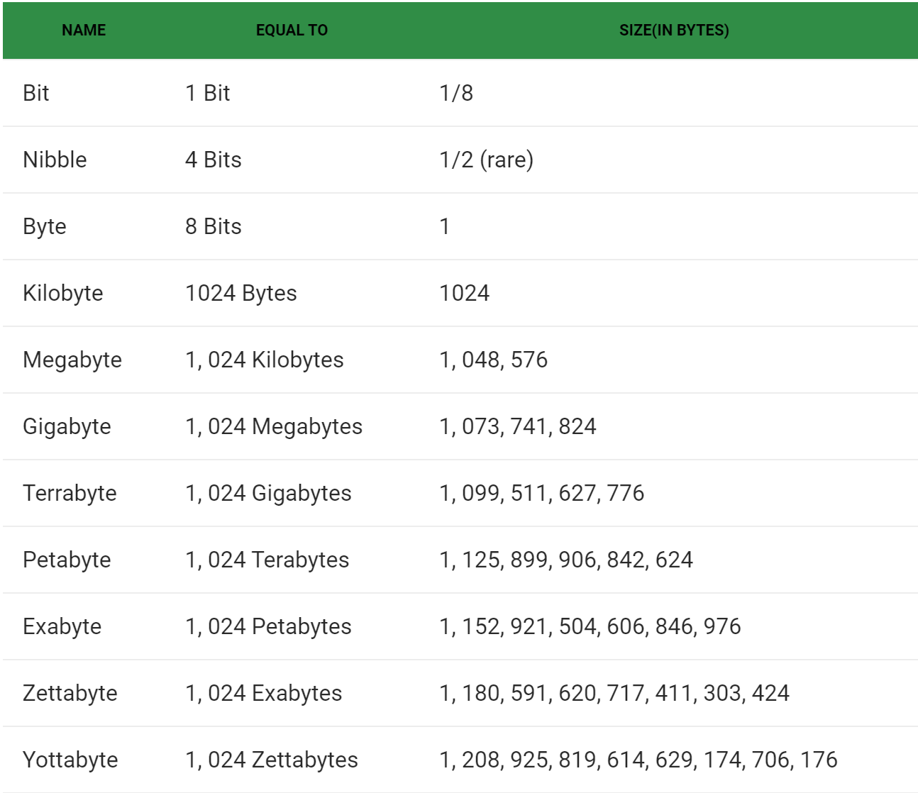
Characteristics of Big Data
Big Data Analytics

Slide 9
Data Structures
Variety: different forms
  Structured: databases, spreadsheets, …
  Semi-structured: textual files such as Web pages, XML, …
  Unstructured: text documents, images, videos, …
Data growth is increasingly unstructured
  Social media: Facebook, Twitter, …
Big Data Analytics

Slide 10
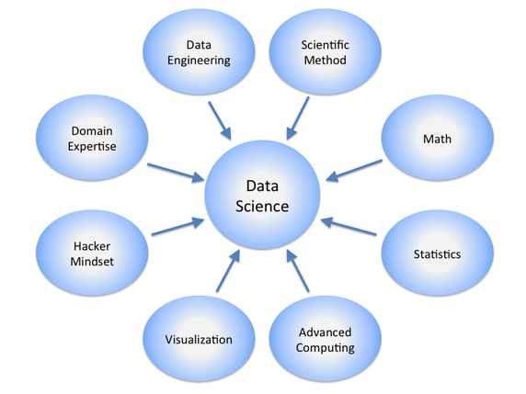
What is Data Science?
Big Data Analytics

Slide 11
Data Engineering vs. Data Analysis
Data engineering: designing and building infrastructure for integrating and managing data from various resources
  MySQL, NoSQL, Hadoop, MapReduce
Data analysis: querying and processing data, providing reports, summarizing and visualizing data
  Statistics, visualization, Excel, SAS, SPSS, …
Data science: applying statistics, machine learning and analytic approaches to solve critical business problems, and turning data into valuable and actionable insights
  Advanced data analysis
  Data mining tools, machine learning, statistics, …
Big Data Analytics

Slide 12
Big data vs. Business Intelligence
Business Intelligence (BI) are the set of strategies, processes, applications, data, products, technologies and technical architectures which are used to support the collection, analysis, presentation and dissemination of business information. [source: Wikipedia]
Big Data Analytics

Slide 13
Data Mining in Business Intelligence
Increasing potential
to support
business decisions
End User
Decision Making
Data Presentation
Business
Analyst
Visualization Techniques
Data Mining
Data
Analyst
Information Discovery
Data Exploration
Statistical Summary, Querying, and Reporting
Data Preprocessing/Integration, Data Warehouses
Data Sources
DBA
Paper, Files, Web documents, Scientific experiments, Database Systems
[source: Han 2011]
Big Data Analytics

Slide 14
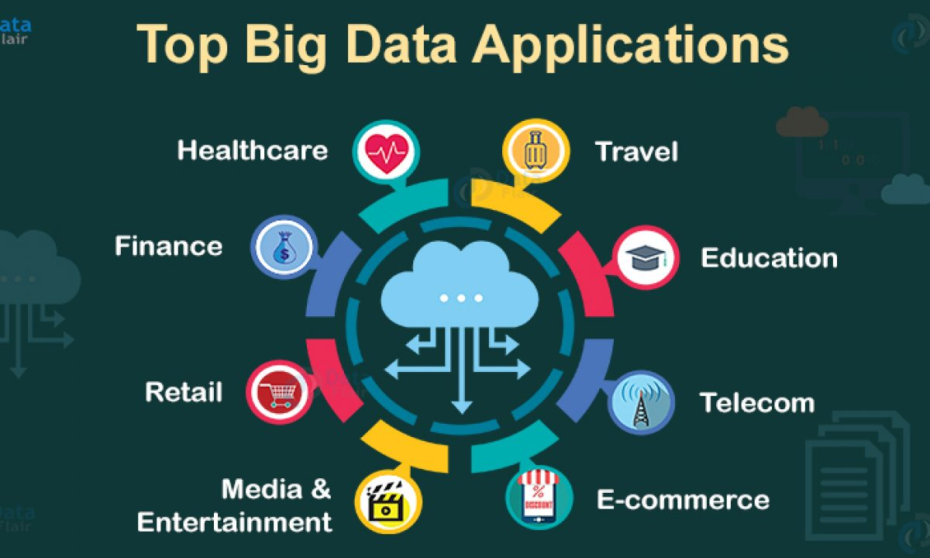
Image source: www.studytonight.com
Big Data Analytics,

Slide 15
Big Data vs. IoT
The Internet of things (IoT) is the internetworking of physical devices, vehicles (also referred to as "connected devices" and "smart devices"), buildings, and other items—embedded with electronics, software, sensors, actuators, and network connectivity that enable these objects to collect and exchange data. [source: Wikipedia]
Big Data Analytics

Slide 16
Big Data vs. CPS
A cyber-physical system (CPS) is a mechanism controlled or monitored by computer-based algorithms, tightly integrated with the internet and its users.
In cyber-physical systems, physical and software components are deeply intertwined, each operating on different spatial and temporal scales, exhibiting multiple and distinct behavioral modalities, and interacting with each other in a myriad of ways that change with context.
  E.g.: smart grid, autonomous automobile systems, medical monitoring, process control systems, robotics systems, and automatic pilot avionics
  [source: Wikipedia]
Big Data Analytics

Slide 17
Big Data vs. Data Mining
Data mining is the computational process of discovering patterns in large data sets involving methods at the intersection of artificial intelligence, machine learning, statistics, and database systems. [source: Wikipedia]
Big Data Analytics

Slide 18
Knowledge Discovery (KDD) Process
Knowledge
This is a view from typical database systems and data warehousing communities
Data mining plays an essential role in the knowledge discovery process
Pattern Evaluation
Data Mining
Task-relevant Data
Data Warehouse
Selection
Data Cleaning
Data Integration
[source: Han 2011]
Databases
Big Data Analytics

Slide 19
Data Mining Function: Classification
Classification and label prediction
  Construct models (functions) based on some training examples
  Describe and distinguish classes or concepts for future prediction
    E.g., classify countries based on (climate), or classify cars based on (gas mileage)
  Predict some unknown class labels
Typical methods
  Decision trees, naïve Bayesian classification, support vector machines, neural networks, rule-based classification, pattern-based classification, logistic regression, …
Typical applications:
  Credit card fraud detection, direct marketing, classifying stars, diseases, web-pages, …
Big Data Analytics

Slide 20
Data Mining Function: Cluster Analysis
Unsupervised learning (i.e., Class label is unknown)
Group data to form new categories (i.e., clusters), e.g., cluster houses to find distribution patterns
Principle: Maximizing intra-class similarity & minimizing interclass similarity
Many methods and applications
Big Data Analytics

Slide 21
Limitations of Data Analysis
CPU: computing time to execute the analysis
I/O: how much data can be put in memory per time unit
Memory: how much data can be processed at a time
Big Data Analytics

Slide 22
Data to be analyzed
Tall data: large number of cases
Wide data: large number of features
Tall and wide data: large number of both cases and features
Sparse data: large number of zero entries
Big Data Analytics

Slide 23
Thank You
Big Data Analytics

